Slide 1
CSI3007
ADVANCED PYTHON PROGRAMMING
MODULE-3
MULTITHREADING IN PYTHON

Slide 2
MODULE-3
3.1. Python Multithreading.
3.2. Multiprocessing Multithreading .
3.3. Multiprocessing Basics.
3.4. Threading module
3.5. Example Python multithreading.
3.6. Multithreaded Priority Queue

Slide 3
      3.1. Python Multithreading.

Slide 4
What is a Thread?
In computing, a process is an instance of a computer program that is being executed. Any process has 3 basic components:
(1) An executable program.
(2) The associated data needed by the program (variables, work
space, buffers, etc.)
(3) The execution context of the program (State of process)
A thread is an entity within a process that can be scheduled for execution. Also, it is the smallest unit of processing that can be performed in an OS (Operating System). In simple words, a thread is a sequence of such instructions within a program that can be executed independently of other code.
For simplicity, you can assume that a thread is simply a subset of a process! A thread contains all this information in a Thread Control Block (TCB):

Slide 5
3.1. Python Multithreading.
Each Task is an independent part of the same program.
Multithreading is the ability of a program or an operating system to enable more than one user at a time without requiring multiple copies of the program running on the computer. Multithreading can also handle multiple requests from the same user.

Slide 6
3.1. Python Multithreading.
How does multithreading work?
The extremely fast processing speeds of today's microprocessors make multithreading possible.
Even though the processor executes only one instruction at a time, threads from multiple programs are executed so fast that it appears multiple programs are executing concurrently.

Slide 7
Example of multithreading
Multithreading is used in many different contexts. One example occurs when data is entered into a spreadsheet and used for a real-time application.
When working on a spreadsheet, a user enters data into a cell, and the following may happen:
column widths may be adjusted;
repeating cell elements may be replicated;
And spreadsheets may be saved multiple times as the file is further developed.
Each activity occurs because multiple threads are generated and processed for each activity without slowing down the overall spreadsheet application operation.

Slide 8
How can define a Thread in Python
1.) Creating a Thread without using any class.
2.) Creating a Thread by extending Thread class.
3.) Creating a Thread without extending Thread class.

Slide 9
Thread Class implement Threading
The methods provided by the Thread class are as follows −
run() − The run() method is the entry point for a thread.
start() − The start() method starts a thread by calling the
run method.
join([time]) − The join() waits for threads to terminate.
isAlive() − The isAlive() method checks whether a thread is
still executing.
getName() − The getName() method returns the name of a
thread.
setName() − The setName() method sets the name of a
thread.

Slide 10
Thread Class implement Threading
threading.activeCount()
− Returns the number of thread objects that are active.
threading.currentThread()
− Returns the number of thread objects in the caller's thread control.
threading.enumerate()
− Returns a list of all thread objects that are currently active.

Slide 11
Benefits of Multithreading
For a single process, multiple threads can be used to process and share the same data-space and can communicate with each other by sharing information.
They use lesser memory overhead, and hence they are called lightweight processes.
A program can remain responsive to input when threads are used.
Threads can share and process the global variable's memory.

Slide 12
      3.2. Multiprocessing
      Multithreading.

Slide 13
      3.3. Multiprocessing Basics..

Slide 14
What is multiprocessing?
Multiprocessing refers to the ability of a system to support more than one processor at the same time.
Applications in a multiprocessing system are broken to smaller routines that run independently.
The operating system allocates these threads to the processors improving performance of the system.

Slide 15
Multiprocessing System
A multiprocessing system can have:
Multiprocessor, i.e. a computer with more than one central processor.
Multi-core processor, i.e. a single computing component with two or more independent actual processing units (called “cores”).
Here, the CPU can easily executes several tasks at once, with each task using its own processor.

Slide 16
Why multiprocessing?
Consider a computer system with a single processor. If it is assigned several processes at the same time, it will have to interrupt each task and switch briefly to another, to keep all of the processes going.
This situation is just like a chef working in a kitchen alone. He has to do several tasks like baking, stirring, kneading dough, etc.
So the gist is that: The more tasks you must do at once, the more difficult it gets to keep track of them all, and keeping the timing right becomes more of a challenge.

Slide 17
Example- Multiprocesssor
1.) To Print Number of Cores in a CPU
import multiprocessing
print("Number of cpu : ",
multiprocessing.cpu_count())

Slide 18
Example- Multiprocesssor
2.) To start and End Multiprocessor Example.
work with Multiprocessing, at first we create process object. Then it calls a start() method.
from multiprocessing import Process
def display():
print ('Hi !! I am Python')
if __name__ == '__main__':
p = Process(target=display)
p.start()
p.join()

Slide 19
Example- Multiprocesssor
3.) pass arguments to the function using args
keyword.
from multiprocessing import Process
def display(my_name):
print ('Hi !!!' + " " + my_name)
if __name__ == '__main__':
p = Process(target=display, args=('Python',))
p.start()
p.join()

Slide 20
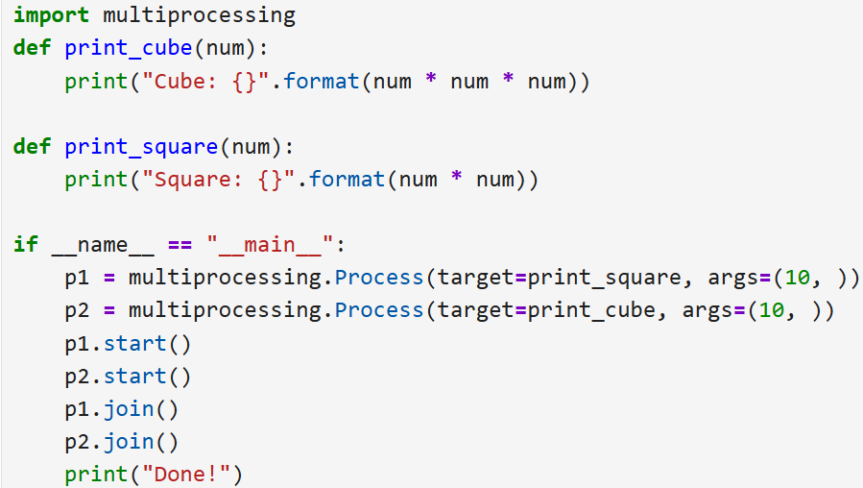
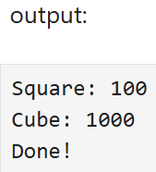
Example- Multiprocesssor

Slide 21
Example- Multiprocesssor
Explanation
Process() creates a new process and assigns a target function.
target specifies the function to execute, while args passes arguments to it.
start() begins process execution.
join() waits for the process to finish before continuing.
p1 calculates the square and p2 calculates the cube.
Done! is printed after both processes complete.

Slide 22
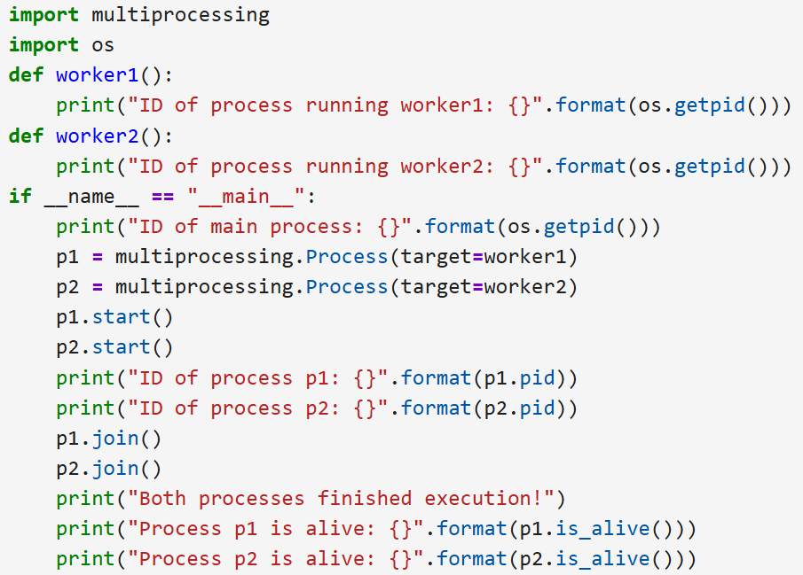
Example- Multiprocesssor
Checking Process ID and Status

Slide 23
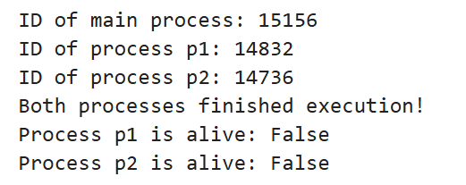
Example- Multiprocesssor
Checking Process ID and Status
OUTPUT
Explanation:
os.getpid() returns the ID of the process currently executing the
function.
p1.pid and p2.pid give the IDs assigned to the created processes.
The process IDs of worker1() and worker2() match their
corresponding process objects.
join() waits for both processes to finish.
is_alive() checks whether a process is still running.
After join(), both processes have finished, so is_alive() returns False.

Slide 24
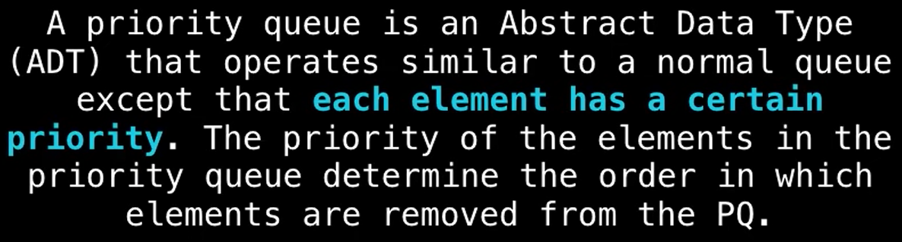
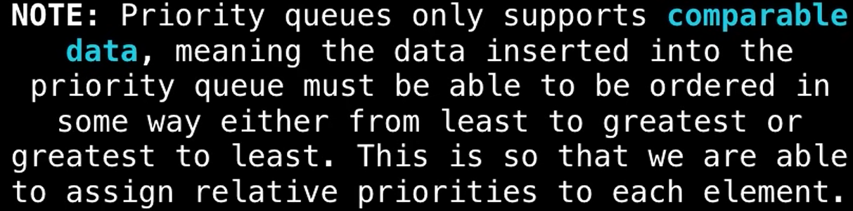
What is Priority Queue

Slide 25
3.6. Multithreaded Priority Queue
The Queue module is primarily used to manage to process large amounts of data on multiple threads.
It supports the creation of a new queue object that can take a distinct number of items.
The get() and put() methods are used to add or remove items from a queue respectively.
Below is the list of operations that are used to manage Queue:

Slide 26
3.6. Multithreaded Priority Queue
The Queue module allows you to create a new queue object that can hold a specific number of items.
There are following methods to control the Queue −
get() − removes and returns an item from the
queue.
put() − adds item to a queue.
qsize() − returns the number of items that are
currently in the queue.
empty() − returns True if queue is empty; otherwise,
False.
full() − returns True if queue is full; otherwise, False.

